Slide 1
Employee data analysis using Excel
STUDENT NAME :HARINI.R
REGISTER NO:312210164
DEPARTMENT :B.COM(COMPUTER APPLICATIONS )
NMId:2B36AB0FFBB0423A1104894021E67139
Department: b.com(COMPUTER APPLICATIONS)
College Name: valliammal college for women

Slide 2
Project tittle
Employee performance analysis
using Excel

Slide 3
Agenda
Problem statement
Project overview
End users
Our solution and Proposition
Data description
Modeling approach
Results and discussion
Conclusion

Slide 4
Problem statement
Analysing employee performance enables organizations to optimize productivity by ensuring that employees are working efficiently and effectively towards their goals.

Slide 5
Project overview
Analyze the Salary of the employee By considering various factors like Gender, employee ID, Start date, employee type, department etc. Different categories of employee salary like Very high, high, medium and low .

Slide 6
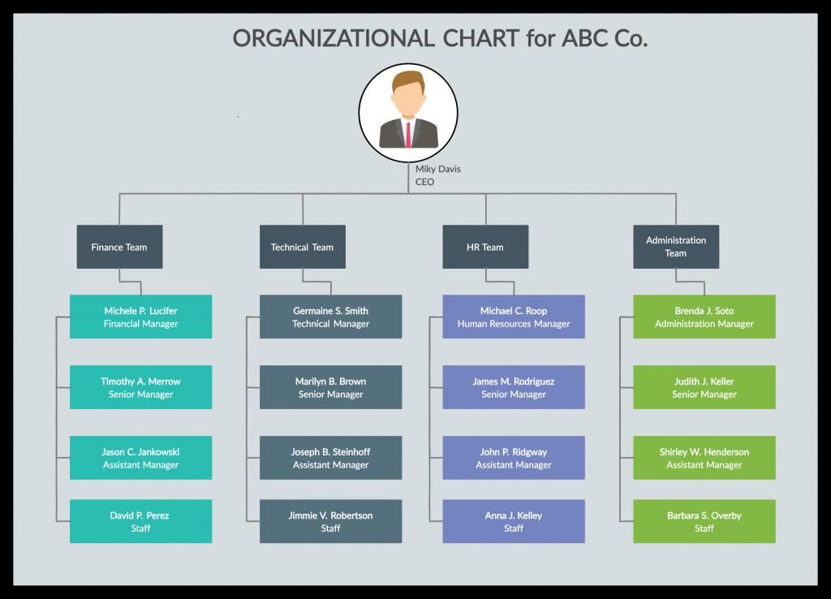

Who are the end users?

Slide 7
Our solution and It’s value proposition
Conditional formatting – missing
Filter – Remove
Formula – performance level
Pivot – summary
Graph – data visualization

Slide 8
Dataset description
Employee dataset – edunet dashboard
26 - features
9 – features
Employee id – numerical value
Name – text
Gender – text
Salary – numerical value
Start date – numerical value

Slide 9
The “wow” in our solution
We use this formula
Ifs(z8>=5,”very high”,Z8>=4,”high”,z8>=3,”med”, true”, low”)

Slide 10
Modeling
Data collection
Nan mudhalvan
Edunet dashboard
Feature selection
26 features
9 features
Data Cleaning
Colour blank values
Filter – remove blank values

Slide 11
Salary level
Very high
High
Medium
Low
Pivot table
Employee id
Name
Gender
Salary
Salary level
Start date
Employee type

Slide 12
Chart
Employee id
Name
Gender
Salary
Salary level
Start date
Employee type
Data visualization

Slide 13
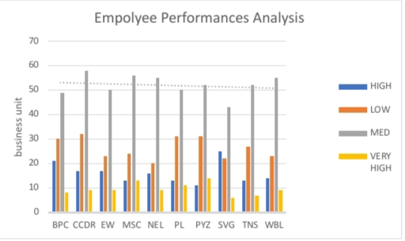
Results

Slide 14
Conclusion
While comparing The salary level Of the employee , the employees are getting Their salary According to Their Employee type and start date.

